Slide 1
Lesson 1.1
Translating & Creating Expressions
EQ: How are verbal phrases translated into algebraic
expressions? (standard A.SSE.1)
40 Expressions
1.1.1: Identifying Terms, Factors, and Coefficients

Slide 2
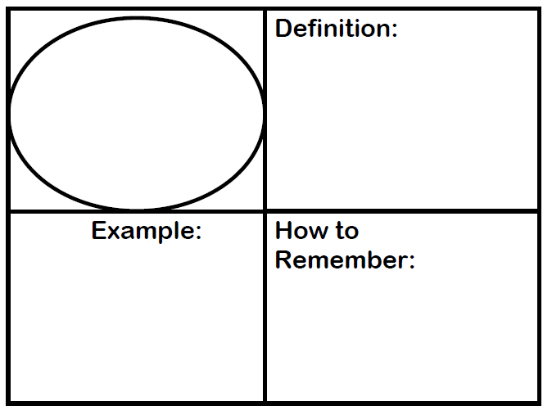
Vocabulary Review
Two or more terms that include one or more variables.
Algebraic Expression
$$5x^{2}+3x−2$$
Root word of algebraic is algebra – must have at least 1 variable
1.1.1: Identifying Terms, Factors, and Coefficients

Slide 3
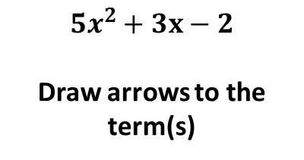
Vocabulary Review
Numbers or variables separated by + or – signs
Term
$$5x^{2}+3x−2$$
Draw arrows to the term(s)
In school you have 4 terms (1st, 2nd, 3rd, 4th) they are separated
1.1.1: Identifying Terms, Factors, and Coefficients

Slide 4

Vocabulary Review
A number multiplied to a variable.
Coefficient
$$5x^{2}+3x−2$$
Draw arrows to the Coefficient(s)
Prefix ‘co’ means together (think of
co-worker)
1.1.1: Identifying Terms, Factors, and Coefficients

Slide 5
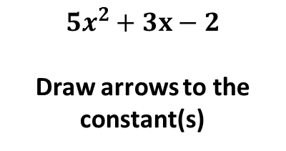
Vocabulary Review
A term that does not have a variable.
Constant
$$5x^{2}+3x−2$$
Draw arrows to the constant(s)
Constant means remains the same (no variable gets multiplied)
1.1.1: Identifying Terms, Factors, and Coefficients

Slide 6
Example 1:
Complete the table for the following expression
Expression | 4x² + 3x + 7
Terms
Coefficients
Constants
1.1.1: Identifying Terms, Factors, and Coefficients

Slide 7
Example 2:
Complete the table for the following expression
Expression | 5x² + x – 2
Terms
Coefficients
Constants
1.1.1: Identifying Terms, Factors, and Coefficients

Slide 8
You Try:
Complete the table for the following expression
Expression | 9x² – 4x + 7
Terms
Coefficients
Constants
1.1.1: Identifying Terms, Factors, and Coefficients

Slide 9
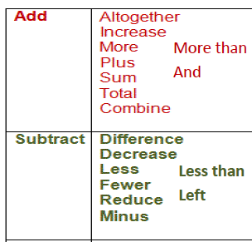
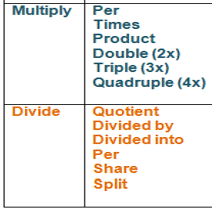
Key Words for translating verbal expressions to algebraic expressions
1.1.1: Identifying Terms, Factors, and Coefficients

Slide 10
Directions: Translate the following verbal expressions to algebraic expressions.
Five more than x
The quotient of x and 2
Two less than 7 times a number, y
Three more than the product of 4 and a number, x
Sarah’s age, a, decreased by 2
Earns $8 per hour for x hours
1.1.1: Identifying Terms, Factors, and Coefficients

Slide 11
Directions: Translate the following verbal expressions to algebraic expressions.
7. There are twice as many flute players as there are
trumpet players in the band. If there are n trumpet
players, write an algebraic expression to find out how
many flute players there are.
8. The Nile River is the longest river in the world at 4,160 miles. A group of explorers traveled along the entire Nile in x days. They traveled the same distance each day. Write an algebraic expression to find each day’s distance.
1.1.1: Identifying Terms, Factors, and Coefficients

Slide 12
You Try!
9. Zach watches TV triple the amount that Joel watches TV. Write an algebraic expression to represent how much TV Zach watches if j represents how much TV Joel watches.
10. Nadia and some friends went to a movie. Their total cost was $30.24. If f represents Nadia and her friends, write an algebraic expression to represent the final price each person paid for their movie ticket.
1.1.1: Identifying Terms, Factors, and Coefficients

