Slide 1
Lesson 1.3 Creating and Solving Equations
EQ: How can I create and use equations to solve word problems? (Standard A.CED.1)

Slide 2
How to create equations from word problems
Steps:
Read the problem carefully.
Make a table or chart of the known quantities.
Identify the unknown variable.
Create an equation from the known quantities and unknown variable.
Solve the equation.
Interpret the results in terms of the problem and convert units when appropriate.

Slide 3
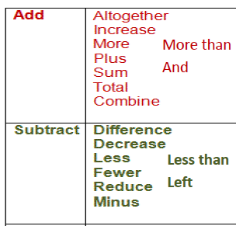
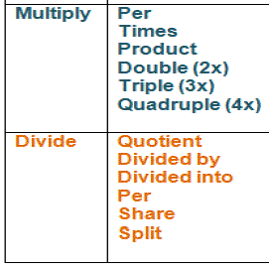
Remember to Look for Keywords!
Key Words preceding
Equal Sign =
Is
Was
Total of

Slide 4
Example 1
It costs Raquel $5 in tolls to drive to work and back each day, plus she uses 3 gallons of gas. It costs her a total of $15.50 to drive to work and back each day. How much per gallon is Raquel paying for her gas?

Slide 5
Example 2
Brianna has saved $600 to buy a new TV. If the TV she wants costs $1,800 and she saves $20 a week, how many years will it take her to buy the TV?

Slide 6
You try!
Malik spent $30 at the mall. He bought a shirt for $25.50 and 3 cookies. Write an equation representing how much each cookie cost.

Slide 7
The Evolution of the cell phone

Slide 8
Example 3
A smartphone is on sale for 25% off its list price. The sale price of the smartphone is $149.25. Write an equation to represent the original list price of the smartphone?

Slide 9
Example 4
Helen purchased 3 copies of a book online at a 20% discount. She also paid $10 for shipping that was not discounted. How much was the original price of one copy of the book if her total ended up being $40?

Slide 10
You try!
James earns $15 per hour as a teller at a bank. In one week, he pays 17% of his earnings in state and federal taxes. His take-home pay for the week is $460.65. How many hours did James work?

