Slide 1
Lesson 4.5 Functions Fitted to Data
EQ: How can it be determined graphically if a line is a good estimate for a data set?
Standard: S.ID.6 a,c
Vocabulary:
-Scatter Plot
-Slope
-Intercept

Slide 2
Activator
Working in groups, write down everything you can remember about functions.

Slide 3
Introduction
A Scatter Plot is a graph of data on a coordinate plane, where each data pair is represented by a point.
Graphing a function on the same coordinate plane as a scatter plot for a data set allows us to see if the function is a good estimation of the relationship between the two variables in the data set.
The graph and the equation of the function can be used to estimate coordinate pairs that are not included in the data set.

Slide 4
Example 1
Andrew wants to estimate his gas mileage, or miles traveled per gallon of gas used. He records the number of gallons of gas he purchased and the total miles he traveled with that gas.

Slide 5
Example 1
#1
Create a scatter plot showing the relationship between gallons of gas and miles driven.

Slide 6
Example 1

Slide 7
Example 1
#2
Would a linear or exponential function be a better estimate for the data? Explain.
_______________________________________________________________________________________________________________________________________

Slide 8
Example 1
#3
Which function is a better estimate for the function that relates gallons to miles:
$$y=15x or y=22x?$$
There are 3 steps to answering this…

Slide 9
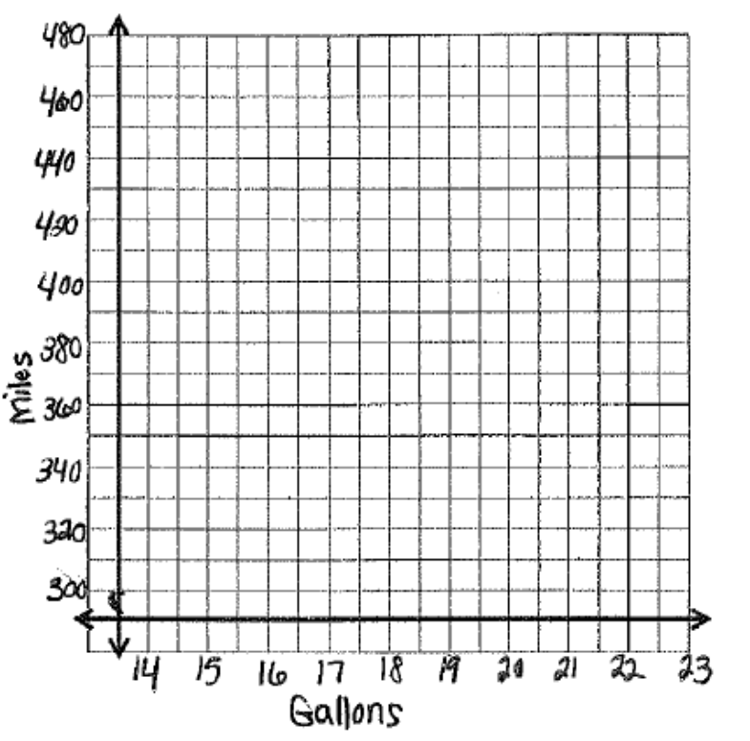
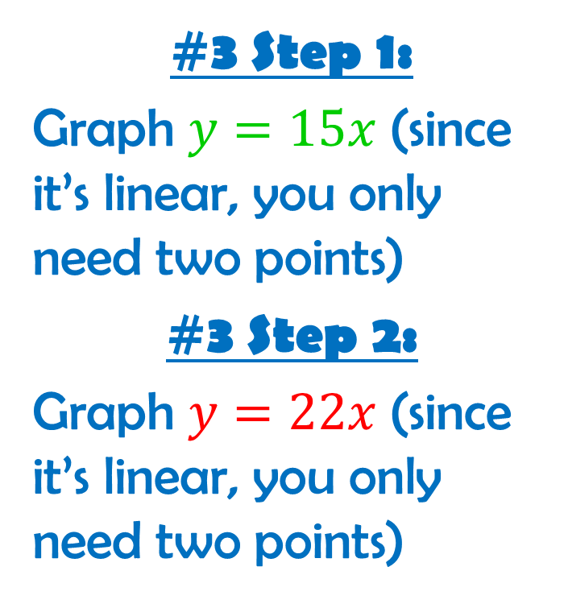
Example 1
#3 Step 1:
Graph $y=15x$ (since it’s linear, you only need two points)
#3 Step 2:
Graph $y=22x$ (since it’s linear, you only need two points)

Slide 10
Example 1
#3 Step 3:
Identify which function comes closer to the data values (this function is the better estimate for the data).
_______________________________________________________________________________________________________________________________________

Slide 11
Example 1
#3 Step 3:
Identify which function comes closer to the data values (this function is the better estimate for the data).
_______________________________________________________________________________________________________________________________________

Slide 12
Example 1
#4:
Interpret the equation in the context of the problem.
Determine the units of slope and the y- intercept:
Slope: ________ Y-intercept: _________

Slide 13
Example 1
#4:
b. Describe what the slope and y-intercept mean in the context of the problem.
____________________________________________________________________________________________________________________________________________________________________________________

Slide 14
Example 2
The principal at Park High School records the total number of students each year. The table below shows the number of students for each of the last 8 years.

Slide 15
Example 2
#1
Create a scatter plot showing the relationship between the year and the total number of students.

Slide 16
Example 2

Slide 17
Example 2
#2
Would a linear or exponential function be a better estimate for the data? Explain.
_______________________________________________________________________________________________________________________________________

Slide 18
Example 2
#3
Show that the function $y=600{(1.05)}^{x}$ is a good estimate for the relationship between the year and the population.
There are 2 steps to answering this…

Slide 19
Example 2
#3 Step 1:
Graph:
$y=600{(1.05)}^{x}$
Make a table of points

Slide 20
Example 2
#3 Step 2:
Compare the graph of the function to the scatter plot of the data.
Why is it a good estimate of the data?
_______________________________________________________________________________________________________________________________________

Slide 21
Example 2
#4:
Approximately how many students will attend the high school in year 9? ______________
(Hint: Use the function to estimate the population in year 9 by using x = 9 in the function)

Slide 22
You Try!
A sandwich shop makes 100 sandwiches each morning to prepare for the day’s orders. Each half hour, they record the number of sandwiches remaining. Use the data to answer the questions that follow.

Slide 23
You Try!
#1
Create a scatter plot showing the relationship between how many hours the shop has been open and the number of sandwiches remaining.

Slide 24
You Try!

Slide 25
You Try!
#2
Would a linear or exponential function be a better estimate for the data? Explain.
_______________________________________________________________________________________________________________________________________

Slide 26
You Try!
#3
Which function is a better fit for the data: $y=−3.8x+92 or y=−5.8x+99$?
There are 3 steps to solving this…

Slide 27
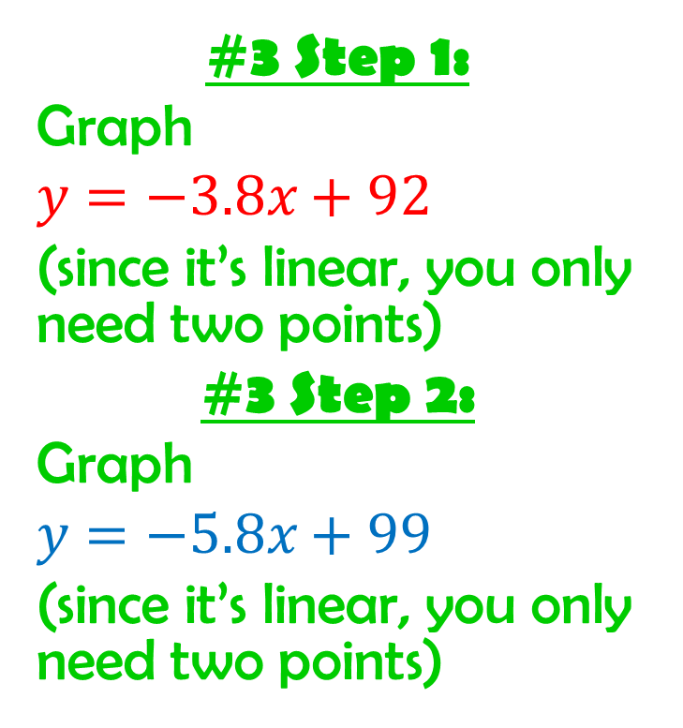
You Try!
#3 Step 1:
Graph
$y=−3.8x+92$
(since it’s linear, you only need two points)
#3 Step 2:
Graph
$$y=−5.8x+99$$
(since it’s linear, you only need two points)

Slide 28
You Try!
#3 Step 3:
Identify which function comes closer to the data values (this function is the better estimate for the data). _______________________________________________________________________________________________________________________________________

Slide 29
You Try!
#4:
Interpret the equation in the context of the problem.
Determine the units of slope and the y- intercept:
Slope: ________ Y-intercept: _________

Slide 30
You Try!
#4:
b. Describe what the slope and y-intercept mean in the context of the problem.
____________________________________________________________________________________________________________________________________________________________________________________

Slide 31
Ticket Out The Door
1. Tell me something you learned today.
2. Tell me something we talked about today that you already knew.
3. Ask one question you are still confused about.

