Slide 1
Lesson 4.6
Best Fit Line
Concept: Using & Interpreting Best Fit Lines
EQs:
-How do we determine a line of best fit from a scatter plot? (S.ID.6 a,c)
-What does the slope and intercept tell me about the data? (S.ID.7)
Vocabulary: Scatter Plot, Slope, Intercept,
Line of best fit

Slide 2
Dear Teacher
On a sheet of paper, write to your teacher what you know about best fit lines and what you hope to learn after today’s lesson.

Slide 3
Before you can find the line of best fit…..
Graph your data
Determine if the data can be represented using a linear model…does the data look linear???
Draw a line through the data that is close to most points. Some values should be above the line and some values should be below the line.
Now you can write the equation of the line.
Let’s try one together.

Slide 4
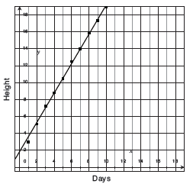
Pablo’s science class is growing
plants. He recorded the height
of his plant each day for 10 days.
The plant’s height, in cm, over
time is in the scatter plot.

Slide 5
GO Best Fit Line
Steps
Example
Identify two points on the
line of best fit
(7, 14), (8, 16)

Slide 6
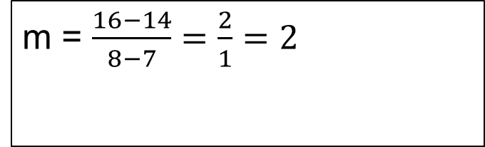
GO Best Fit Line
Steps
Example
Identify two points on the
line of best fit
2. Find the slope of the line
using the points
(7, 14), (8, 16)
m = $\frac{16−14}{8−7}=\frac{2}{1}=2$

Slide 7
GO Best Fit Line
Steps
Example
Identify two points on the
line of best fit
2. Find the slope of the line
using the points
3. Substitute into
y = m(x – x₁) + y₁
(7, 14), (8, 16)
m = $\frac{16−14}{8−7}=\frac{2}{1}=2$
y = 2(x – 7) + 14

Slide 8
GO Best Fit Line
Steps
Example
Identify two points on the
line of best fit
2. Find the slope of the line
using the points
3. Substitute into
y = m(x – x₁) + y₁
4. Simplify
(7, 14), (8, 16)
m = $\frac{16−14}{8−7}=\frac{2}{1}=2$
y = 2(x – 7) + 14
y = 2x – 14 +14
y = 2x

Slide 9
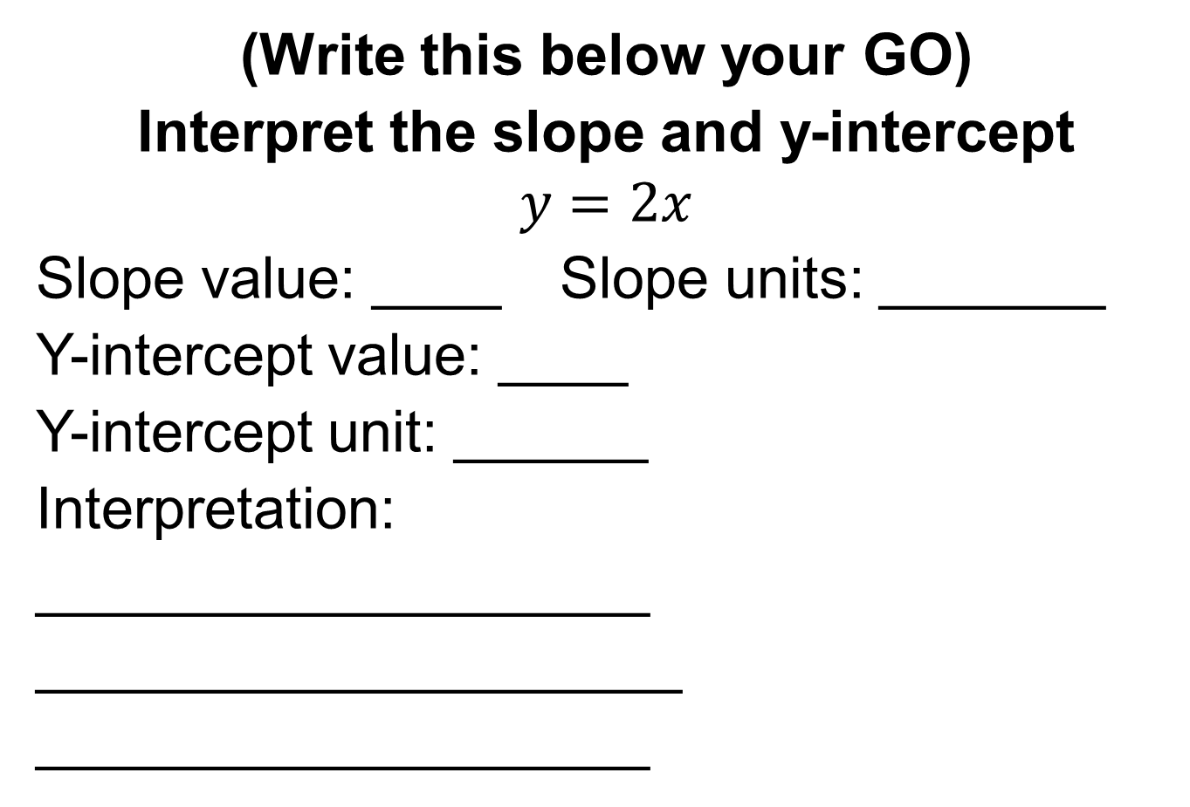
(Write this below your GO)
Interpret the slope and y-intercept
$$y=2x$$
Slope value: ____ Slope units: _______
Y-intercept value: ____
Y-intercept unit: ______
Interpretation:
___________________
____________________
___________________

Slide 10
Guided Practice
Example 1
A weather team records the
weather each hour after
sunrise one morning in May.
The hours after sunrise and
the temperature in degrees
Fahrenheit are in the table
to the right.
Can the temperature 0–7 hours
after sunrise be represented by a
linear function? If yes, find the
equation of the function.
Graph the points!!!
Hours after sunrise | Temperature in ˚F
0 | 52
1 | 53
2 | 56
3 | 57
4 | 60
5 | 63
6 | 64
7 | 67

Slide 11
Guided Practice: Example 1, continued
Create a scatter plot of the data.
  Let the x-axis represent
  hours after sunrise and
  the y-axis represent
  the temperature in
  degrees Fahrenheit.
Temperature (°F)
Hours after sunrise

Slide 12
Guided Practice: Example 1, continued
Determine if the data can be represented by a linear function.
  The graph of a linear equation is a line. If the data looks like it could fit a line, then a linear equation could be used to represent the data.
  The temperatures appear to increase in a line, and a linear equation could be used to represent the data set.

Slide 13
Guided Practice: Example 1, continued
Draw a line to estimate the data set.
  Two points in the data set can be used to draw a line that estimates that data. When the line is drawn, some of the data values should be above the line, and some should be below the line.
  A line through (2, 56) and (6, 64) looks like a good fit for the data.

Slide 14
Guided Practice: Example 1, continued
Temperature (°F)
Hours after sunrise

Slide 15
GO Best Fit Line
Steps
Example
1.
2.
3.
4.

Slide 16
GO Best Fit Line
Steps
Example
Identify two points on the
line of best fit
2.
3.
4.
(2, 56), (6, 64)

Slide 17
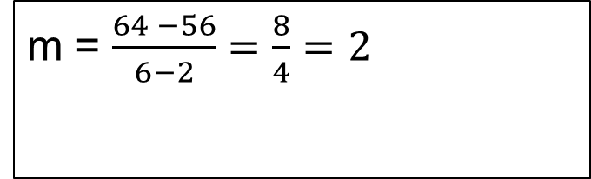
GO Best Fit Line
Steps
Example
Identify two points on the
line of best fit
2. Find the slope of the line
using the points
3.
4.
(2, 56), (6, 64)
m = $\frac{64 −56}{6−2}=\frac{8}{4}=2$

Slide 18
GO Best Fit Line
Steps
Example
Identify two points on the
line of best fit
2. Find the slope of the line
using the points
3. Substitute into
y = m(x – x₁) + y₁
4.
(2, 56), (6, 64)
m = $\frac{64 −56}{6−2}=\frac{8}{4}=2$
y = 2(x – 2) + 56

Slide 19
GO Best Fit Line
Steps
Example
Identify two points on the
line of best fit
2. Find the slope of the line
using the points
3. Substitute into
y = m(x – x₁) + y₁
4. Simplify
(2, 56), (6, 64)
m = $\frac{64 −56}{6−2}=\frac{8}{4}=2$
y = 2(x – 2) + 56
y = 2x – 4 +56
y = 2x +52

Slide 20
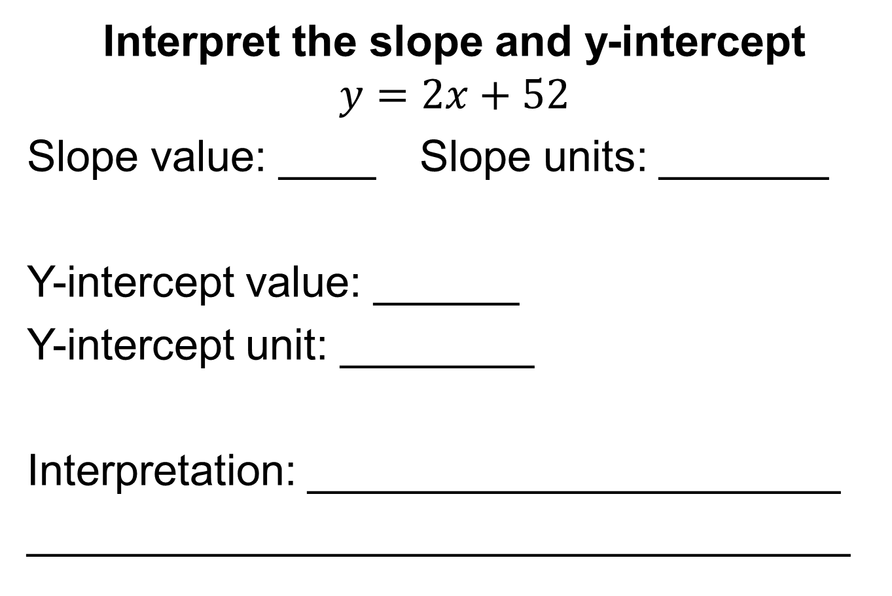
Interpret the slope and y-intercept
$$y=2x+52$$
Slope value: ____ Slope units: _______
Y-intercept value: ______
Y-intercept unit: ________
Interpretation: ______________________
__________________________________

Slide 21
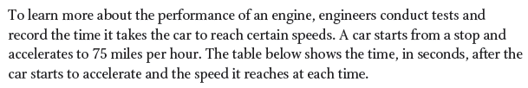
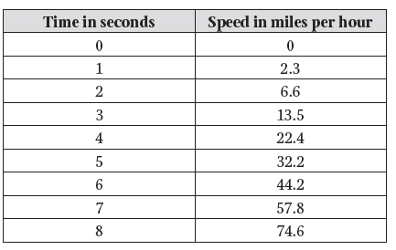
Guided Practice - Example 2
Can the speed between 0
and 8 seconds be represented
by a linear function? If yes,
find the equation of the
function.

Slide 22
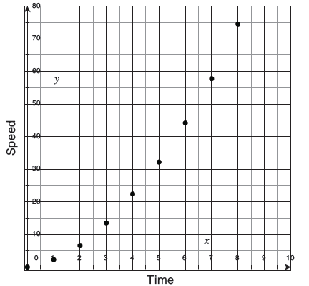
Guided Practice: Example 2, continued
Create a scatter plot of the data.
  Let the x-axis represent
  time and the y-axis
  represent speed.

Slide 23
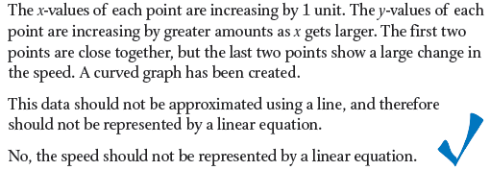
Guided Practice: Example 2, continued
Determine if the data can be represented by a linear function.

Slide 24
Guided Practice - Example 3
Automated tractors can mow
lawns without being driven by
a person. A company runs
trials using fields of different
sizes, and records the amount
of time it takes the tractor to
mow each field. The field sizes
are measured in acres.
Acres | Time in hours
5 | 15
7 | 10
10 | 22
17 | 32.3
18 | 46.8
20 | 34
22 | 39.6
25 | 75
30 | 70
40 | 112
Can the time to mow acres of a field be represented by a linear function? If yes, find the equation of the function.

Slide 25
Guided Practice: Example 3, continued
Create a scatter plot of the data.
  Let the x-axis represent
  the acres and the y-axis
  represent the time
  in hours.
Time
Acres

Slide 26
Guided Practice: Example 3, continued
Determine if the data can be represented by a linear function.
  The graph of a linear equation is a line. If the data looks like it could fit a line, then a linear equation could be used to represent the data.
  The time appears to increase in a line, and a linear equation could be used to represent the data set.

Slide 27
Guided Practice: Example 3, continued
Draw a line to estimate the data set.
  Two points in the data set can be used to draw a line that estimates the data. When the line is drawn, some of the data values should be above the line, and some should be below the line.
  A line through (7, 10) and (40, 112) looks like a good fit for the data.

Slide 28
Guided Practice: Example 3, continued
Time
Acres

Slide 29
GO Best Fit Line
Steps
Example
1.
2.
3.
4.

Slide 30
GO Best Fit Line
Steps
Example
Identify two points on the
line of best fit
2.
3.
4.
(7, 10) and (40, 112)

Slide 31
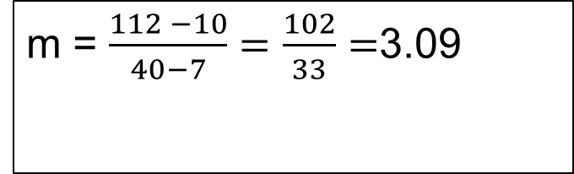
GO Best Fit Line
Steps
Example
Identify two points on the
line of best fit
2. Find the slope of the line
using the points
3.
4.
(7, 10) and (40, 112)
m = $\frac{112 −10}{40−7}=\frac{102}{33}=$3.09

Slide 32
GO Best Fit Line
Steps
Example
Identify two points on the
line of best fit
2. Find the slope of the line
using the points
3. Substitute into
y = m(x – x₁) + y₁
4.
(7, 10) and (40, 112)
m = $\frac{112 −10}{40−7}=\frac{102}{33}=$3.09
y = 3.09(x – 7) + 10

Slide 33
GO Best Fit Line
Steps
Example
Identify two points on the
line of best fit
2. Find the slope of the line
using the points
3. Substitute into
y = m(x – x₁) + y₁
4. Simplify
(7, 10) and (40, 112)
m = $\frac{112 −10}{40−7}=\frac{102}{33}=$3.09
y = 3.09(x – 7) + 10
y = 3.09x – 21.63 + 10
y = 3.09x – 11.63

Slide 34
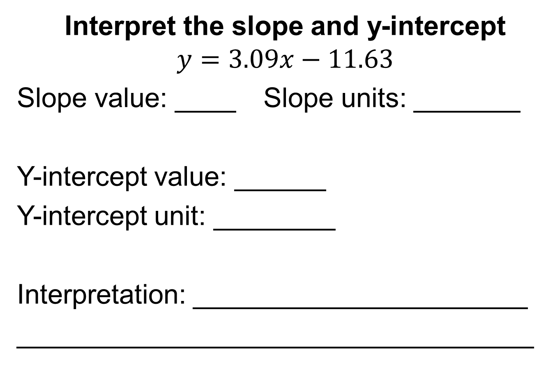
Interpret the slope and y-intercept
$$y=3.09x−11.63$$
Slope value: ____ Slope units: _______
Y-intercept value: ______
Y-intercept unit: ________
Interpretation: ______________________
__________________________________

Slide 35
Resource
http://www.shodor.org/interactivate/activities/Regression/

Slide 36
The Important Thing
On a sheet of paper, write down three things you learned today. Out of those three, write which one is most important and why.

